Slide 1

Removal of Occluding fences from an image
Department of Computer Science & Engineering B.M.S. College of Engineering
By,
Deepthi Bhat (1BM16CS003)
Aditi Awasthi (1BM16CS008)
Medhini Oak (1BM16CS047)
Under the Guidance of,
Dr. Kayarvizhy N.
Associate Professor
B.M.S. College of Engineering

Slide 2
Contents
Problem Statement
Motivation
Existing Systems
Design and Implementation
Results
Conclusion and Future Enhancements
References

Slide 3
Problem statement
To remove occluding objects from images and perform context-aware filling by employing advanced image processing techniques
This has been achieved by using two successive algorithms:
Extraction of the fence mask by using wavelet decomposition and morphological operations – Defencing
Exemplar based filling of the mask with most appropriate pixels - Inpainting

Slide 4
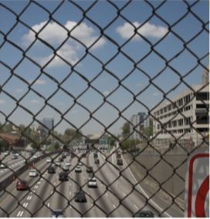
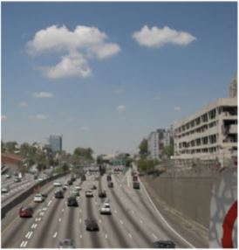
Motivation
The presence of grills, fences and enclosures between a camera and a scene of interest ruins the aesthetic experience of the picture. This gives rise to the need for a tool which can remove the occlusion from the clicked image as if it were never there and replace it with content that blends with the background.
Involves application in various fields like:
Criminology and Surveillance
Wildlife/animal enclosure photography
At tourist spots like museums or high towers

Slide 5
Existing systems - Defencing
Detection of fences in images in (Liu et al [1]) has been done based on texture regularity by considering the fence as a deformed lattice. But these algorithms produced poor robustness, especially with fences of different shapes and color.
More recently, fence detection has been performed by (Wang et al [2]) based on vertical distribution of horizontal edges. But this method could not provide fence extraction.
(Mu et al [3]) described a method involving automatic detection of fences from video clips. However, this method was ineffective when the depth of the fence was the same as the background.

Slide 6
Existing systems - Inpainting
Algorithms on inpainting were initially based on texture synthesis, however these algorithms did not provide satisfactory results in terms of visual appearance.
Content aware algorithms have been proposed by (Yoshida et al[4]) that use Deep Convolutional Generative Adversarial Net. While it did produce better results, its effectiveness is limited to the training of its dataset.
(Criminisi et al [5]) introduced an exemplar based inpainting algorithm to inpaint pictures which was able to produce better visual results than any existing algorithm. However, the algorithm was very slow and inefficient.
Defencing and inpainting have been tackled as separate problems in earlier research works, but never together due to the complexity involved. This is what our project aims to achieve

Slide 7
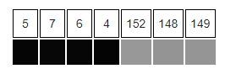
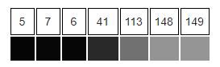
Why is it a non-trivial task?
Consider the problem of detecting edges in the following one-dimensional signal. Here, we may intuitively say that there should be an edge between the 4th and 5th pixels.
If the intensity difference were smaller between the 4th and the 5th pixels and if the intensity differences between the adjacent neighboring pixels were higher, it would not be as easy to say that there should be an edge in the corresponding region. Moreover, one could argue that this case is one in which there are several edges.
Hence, to firmly state a specific threshold on how large the intensity change between two neighbouring pixels must be for us to say that there should be an edge between these pixels is not always simple.

Slide 8
Design and implementation

Slide 9
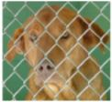
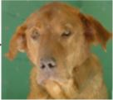
High Level Design
Defencing
Inpainting
Texture Detection to identify Fences
Confidence and Data Computation
Wavelet Decomposition for constructing fence mask
Exemplar based completion
Input Image
Output Image
Morphological closing of pixelated mask

Slide 10
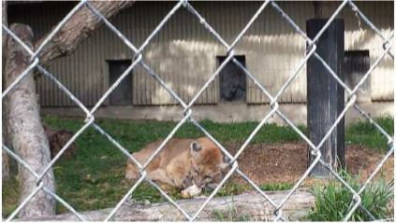
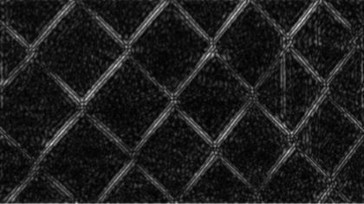
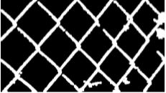
Detailed Design – Defencing^{[6]}
Identifying fence patterns appearing in the foreground of images
Original picture
Initial Fence Mask
Manipulation in frequency domain
Conversion to spatial domain
Wavelet Decomposition
Final Fence Mask
Morphological closing
‹#›

Slide 11
Detailed Design – Defencing^{[6]}
Original picture
Initial Fence Mask
Manipulation in frequency domain
Conversion to spatial domain
Wavelet Decomposition
Final Fence Mask
Morphological closing
‹#›

Slide 12
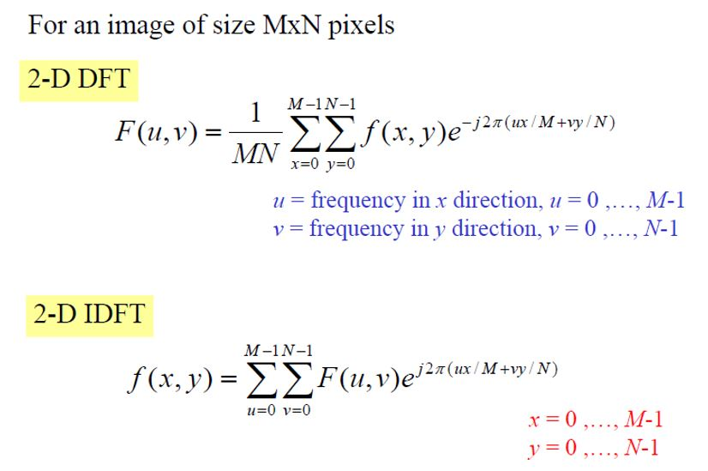
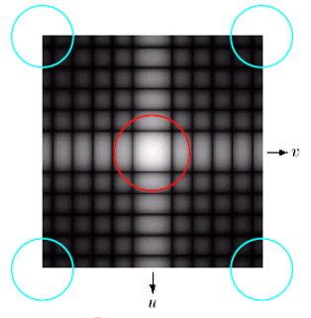
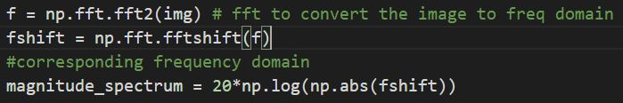
Manipulation in frequency domain
Image is converted to the frequency or Fourier domain which deals with the rate at which the pixel values are changing in spatial domain.
This is done using the Fourier transform.
High frequency components correspond to edges in an image
Removal of Occluding fences from an image Dept of CSE, BMSCE

Slide 13
Detailed Design – Defencing^{[6]}
Original picture
Initial Fence Mask
Manipulation in frequency domain
Conversion to spatial domain
Wavelet Decomposition
Final Fence Mask
Morphological closing
‹#›

Slide 14
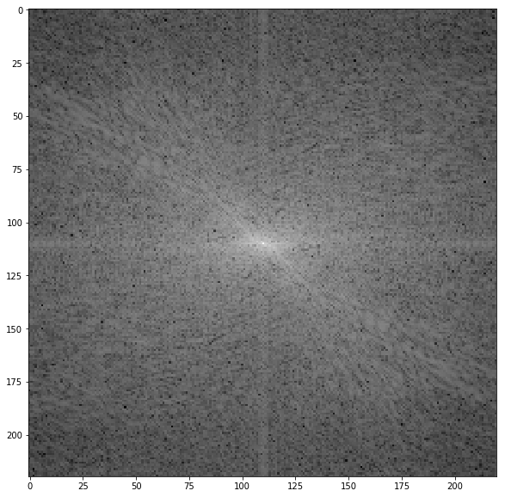
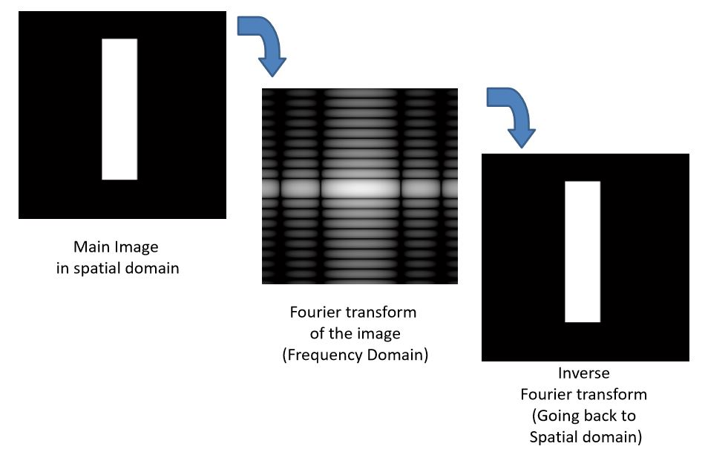
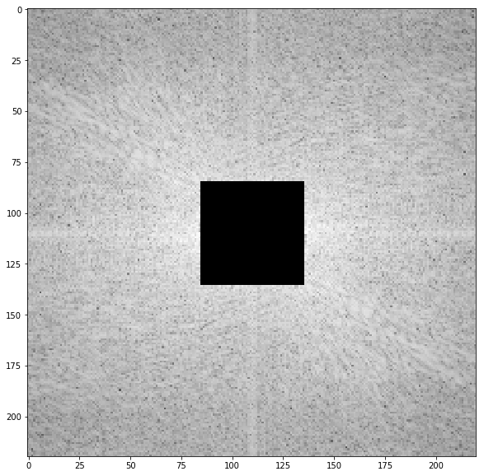
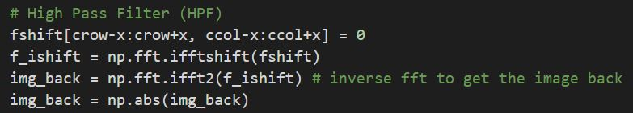
Quasi-periodic texture filtering
High pass filter – which allows only high frequencies to go through - can be used to sharpen an image and isolate the edges which constitute it.
Applying a band pass filter helps reduce noise in those edges
The image is then inverse-transformed back to the spatial domain
High Pass Filter

Slide 15
Detailed Design – Defencing^{[6]}
Original picture
Initial Fence Mask
Manipulation in frequency domain
Conversion to spatial domain
Wavelet Decomposition
Final Fence Mask
Morphological closing
‹#›

Slide 16
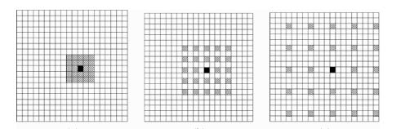
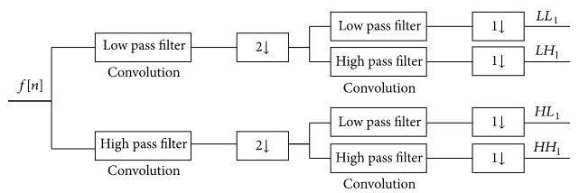
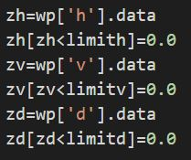
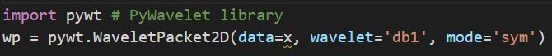
Wavelet Decomposition – Multiresolution Processing
A multiresolution representation of provides a simple hierarchical framework to analyze the signal at different resolution level.
Wavelets represent the scale of features in an image, as well as their position. It is applied to the image results in diagonal (D), vertical (V), and the horizontal (H) components which are employed for feature extraction.
Orthogonality represents a unique and complete representation of a signal. Each stage of the algorithm generates wavelets with sequentially finer representation of signal content.

Slide 17
Detailed Design – Defencing^{[6]}
Original picture
Initial Fence Mask
Manipulation in frequency domain
Conversion to spatial domain
Wavelet Decomposition
Final Fence Mask
Morphological closing
‹#›

Slide 18

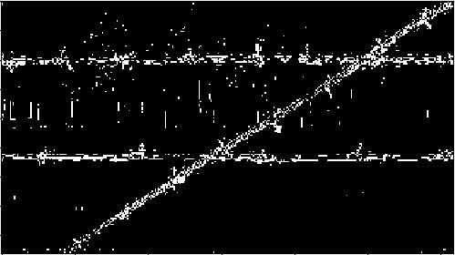
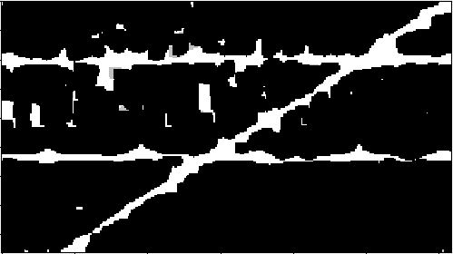
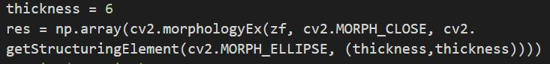
Morphological closing
Morphological transformations are simple operations based on the image shape.
It needs two inputs, one is our original image, second one is called structuring element or kernel
Two basic morphological operators are Erosion and Dilation.
Morphological close
We use the Morphological close operation to convert the pixelated fence mask to a fence mask which is acceptable by the inpainting algorithm
Closing = Dilation followed by Erosion. It is useful in closing small holes inside the foreground objects, or small black points on the object.

Slide 19
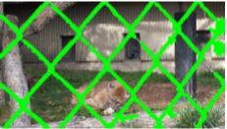
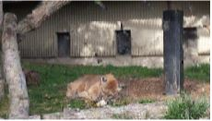
Detailed Design - Inpainting^{[5]}
Reconstruction of missing patches in images
Confidence and Data Computation
Exemplar based completion
Mask applied to image
Final Result
‹#›

Slide 20
Detailed Design - Inpainting^{[5]}
Confidence and Data Computation
Exemplar based completion
Mask applied to image
Final Result
‹#›

Slide 21
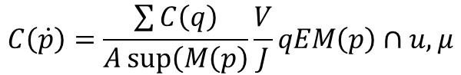
Exemplar Based Inpainting
An iterative algorithm comprising two major steps:
Choosing the missing region to fill
Selecting an exemplar region to fill it with.
Image Complete?
Final Fence Mask
Extract Initial Mask
Initialize Criminisi’s Confidence term and Data term
Yes
No
Identify Filling Area
Fill patch using exemplar portion as reference
Find Exemplar portion for max-priority patch
Compute priorities, find max priority patch
Update Confidence and Data terms

Slide 22
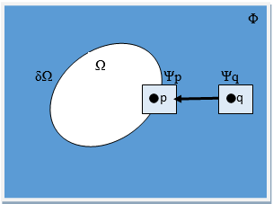
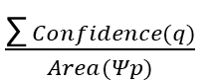
Confidence and Data term Computation
Initialization:
Confidence (p) =0, if pixel p belongs to the mask
Confidence (p) =1, if pixel p does not belong to
Data [] = [0]
Calculation:
Confidence (p) =
∀ q ∈ (Ψp ∩ (Working Mask)’)
Data (p) = unit normal (p) * max_gradient (p)
max_gradient (p) - Max relative difference in grayscale intensity of patch that surrounds pixel p
unit_normal (p) - Used for clear edge detection by performing a convolve operation on the working mask
‹#›
Notes:
Unit normal - Using the Sobel Edge operator which removes the noise and provides a smoothing effect on the mask by clearly highlighting the edge of the mask

Slide 23
Detailed Design - Inpainting^{[5]}
Confidence and Data Computation
Exemplar based completion
Mask applied to image
Final Result
‹#›

Slide 24
Exemplar Based Completion - Algorithm
Repeat until done:
1. Identify the ﬁll front. If fill front does not exist, exit.
2. Compute priorities P(p),where p is the pixel belonging to the fill front.
Priority(p) = Confidence(p) * Data(p)
3. Find the pixel p with maximum priority and derive the target patch Ψp around it.
4. Find the exemplar patch Ψq which has the minimum sum of squared differences with target patch Ψp.
5. Copy image data from Ψq to Ψp.
6. Update the Confidence and Data of the newly filled patch Ψp.
‹#›

Slide 25
Results
Outcomes of the project

Slide 26
Data Analysis for inpainting
Input:
Image to be inpainted and mask with fence pixels in white and background pixels is black.
Output:
Image with the given mask pixels inpainted using background information
Constraints:
The dimensions of the input image and the mask should be the same.

Slide 27
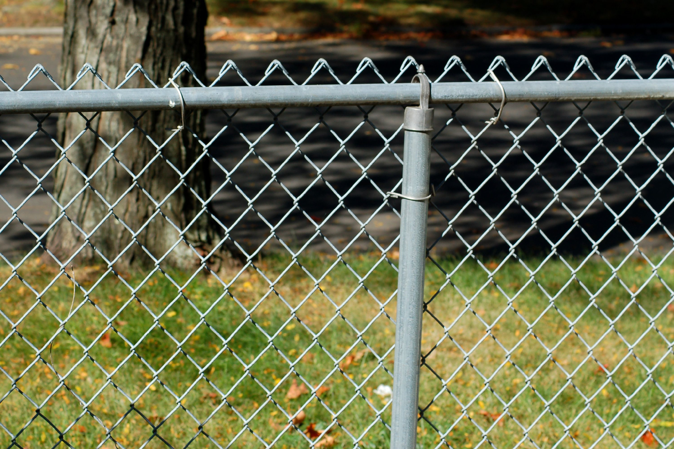
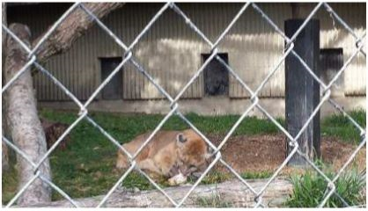
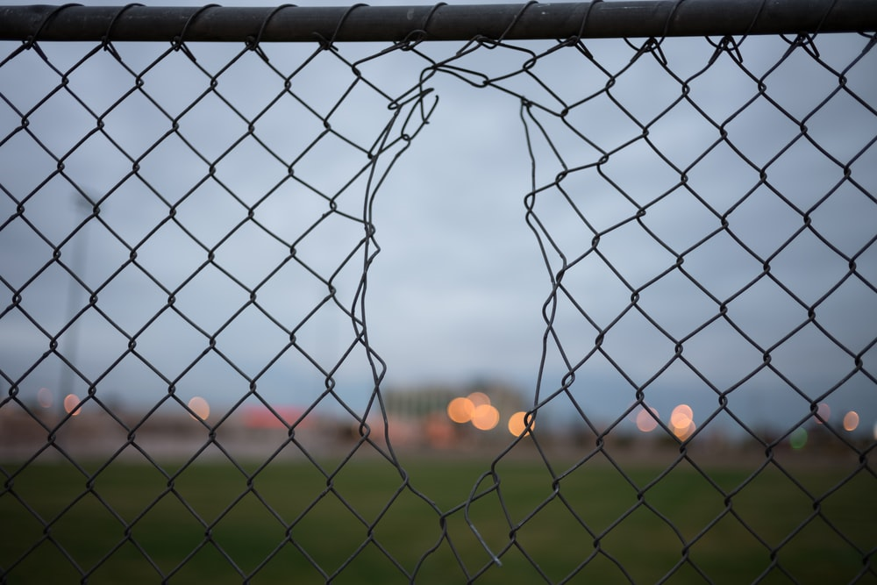
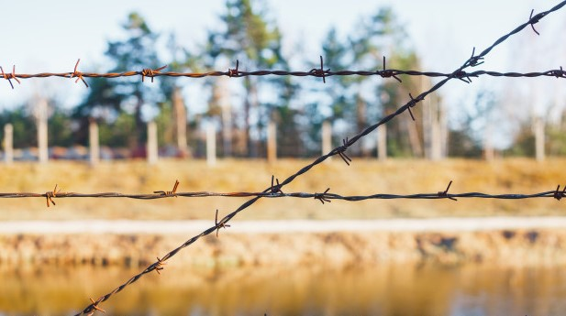
Types of images given as input
Low resolution
Regular fence
Low resolution
Regular fence
Medium-high resolution
Broken fence
Medium-low resolution
Irregular fence

Slide 28

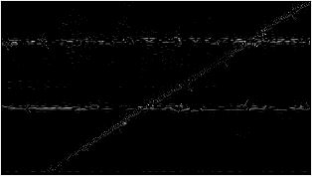
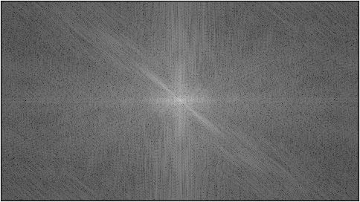
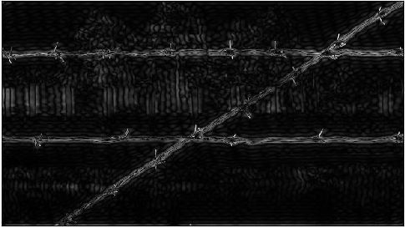
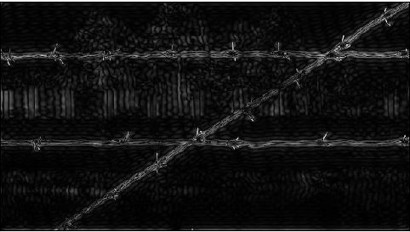
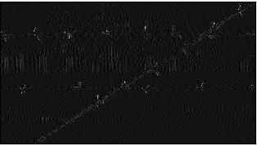
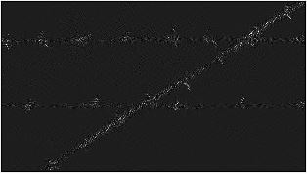
Defencing
Horizontal
Original Picture
OR
Frequency Domain
HPF
BPF
Vertical
Combined Mask
Diagonal

Slide 29
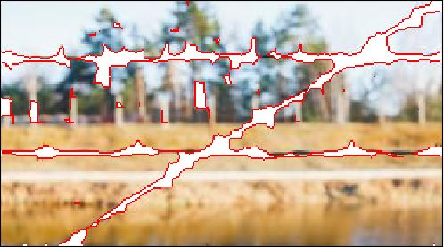
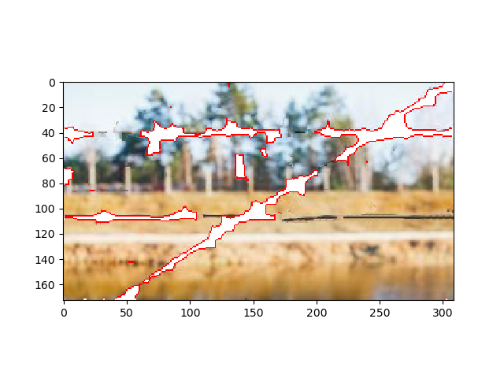
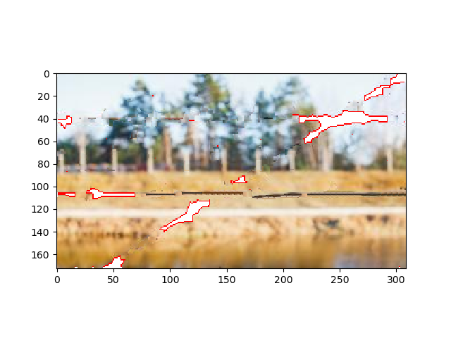
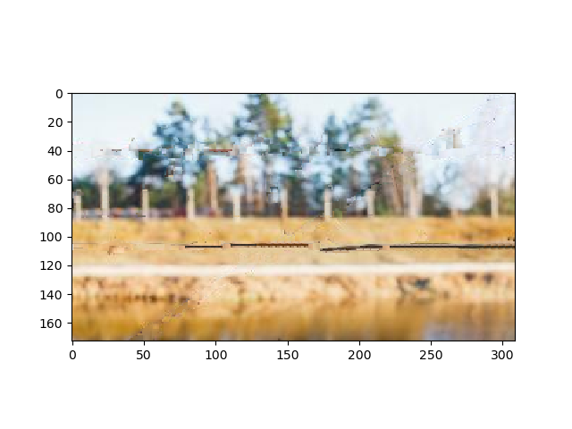
Inpainting
Final Mask
Working Image
In-painted Image
Inpainting process

Slide 30
Conclusion
This project improves on existing systems by automating the process of detecting and inpainting over fences and optimising the algorithm to produce faster and better visual results by applying complex mathematics and algorithms.
It potentially saves hours of work if handled manually. We hope this tool is incorporated into the mainstream set of tools that are used professionally and that image processing experts contribute to make it even more effective.

Slide 31
Future Enhancements
Improve on the accuracy of the fence mask, especially with low resolution images
Increase the efficiency of the inpainting algorithm
Try to reduce the number of variable factors involved in producing the fence mask
Remove dependency on controlled illumination level

Slide 32
References
[1] Liu, Yanxi, Tamara Belkina, James H Hays and Roberto Lublinerman (2008). Image de-fencing. In: Proc. IEEEConf. Computer Vision and Pattern Recognition. pp. 1–8.
[2] J. Yang, J. Wang, L. Liu, and C. Hou, “RIFO: Restor-ing images with fence occlusions,” in Proc. 2015 IEEE17th International Workshop on Multimedia Signal Pro-cessing (MMSP) (Xiamen, China, 2015), pp. 1–6.
[3] Y. Mu, W. Liu, and S. Yan, “Video de-fencing,” IEEE Trans. Circts. Sys. Vid. Tech., vol. 24, no. 7, pp. 1111–1121, 2014.
[4] Chenduo Huang & Koki Yoshida, (2017). Evaluations of Image Completion Algorithms: Exemplar-Based Inpainting vs.Deep Convolutional GAN. Stanford University.
[5] A. Criminisi, P. Perez, and K. Toyama, “Region filling and object removal by exemplar-based image inpainting,” IEEE Trans. Image Process., vol. 13, no. 9, pp.1200–1212, 2004.
[6] Hettiarachchi, Randima & Peters, James & Bruce, Niel. (2014). Fence-like Quasi-periodic Texture Detection in Images. Theory and Applications of Mathematics & Computer Science. 4.

Slide 33
Thank you

